Slide 1
Stock Price Prediction (Sentiment Analysis + LSTM)
CSIS 4260 - Special Topics in Data Analytics
Section: 002 - Winter 2024
Instructor: Nikhil Bhardwaj
Presented by:
David Gallego Duque – 300359553
Leonardo Meneguetti Barbosa - 300364434

Slide 2


Agenda
Dataset for Sentiment Analysis
Dataset for Stock Price Company
Sentiment Analysis
LSTM
LSTM + Sentiment Analysis
Conclusions
References
*All data, codes and this presentation are available at: https://github.com/LeoMeneguetti/CSIS4260_SpecialTopics
Notes:
These are the steps that we followed throughout the project, and we will cover them in this presentation.

Slide 3
Dataset for Sentiment Analysis

Slide 4
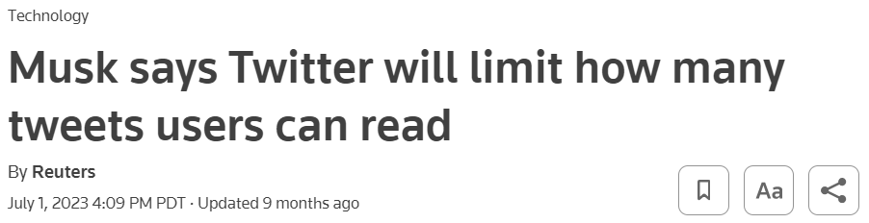
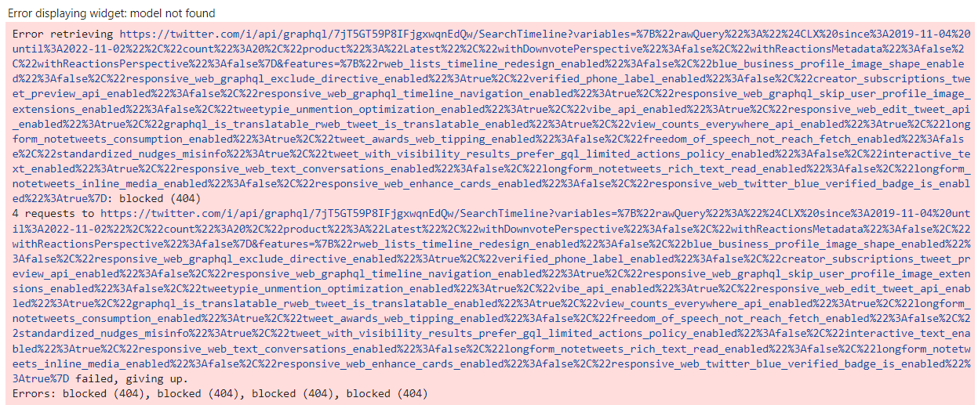

Dataset for Sentiment Analysis
Notes:
In the first moment, the idea was to pull out tweets directly from Twitter. However, when running the code, we figured out that it is no longer possible.
Therefore, we decided to move forward with plan B and use a news dataset from Kaggle.

Slide 5

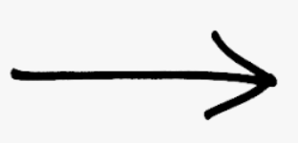

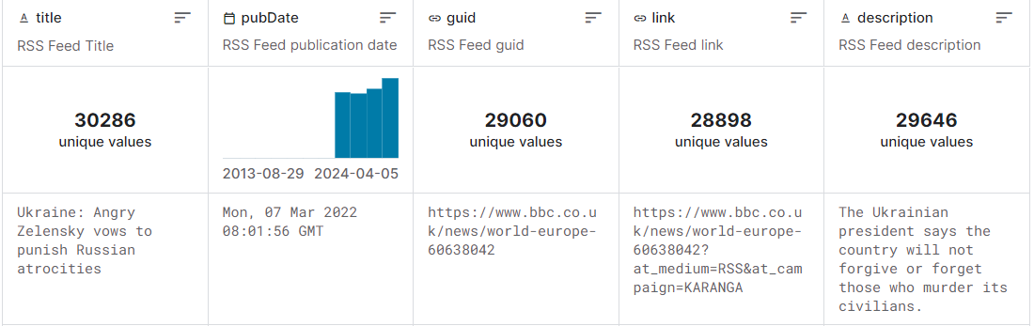

Dataset for Sentiment Analysis
This dataset collects RSS (Rich Site Summary) feeds from BBC. There is no specific target content in this dataset. This means that it contains news of all types.
Data set period: from Jan/2022 to Mar/2024.
Number of features: 5 (title, pubDate, guid, link, descfription)
Notes:
This Kaggle dataset contains general news from the BBC spanning from January 2022 to March 2024. It comprises 5 features and over 30,000 rows. It is a time series dataset. As an example, here is the first row of our dataset.

Slide 6
Dataset for Stock Price Company

Slide 7


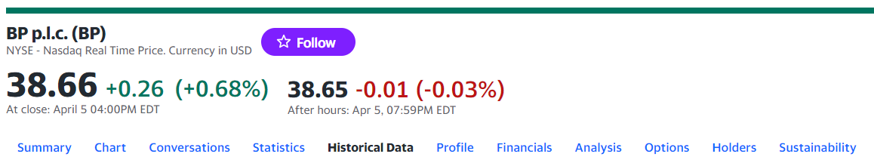
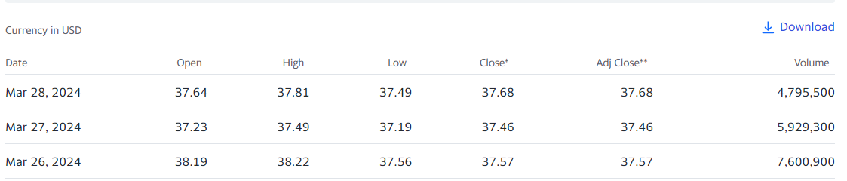
Dataset for Stock Price Company
BP p.l.c. (formerly The British Petroleum Company) is a British multinational oil and gas company with headquartered in London, England.
Founded: 14 April 1909 | Revenue: US$210.13 billion (2023) | Number of employees: 87,800 (2023)
Data set period: from Jan/2022 to Mar/2024.
7 Features
Notes:
BP is the company selected for the analysis of its stock price. We chose BP under the assumption that the period covering the Sentiment Analysis of BBC news (2022-2024) may contain relevant information about the Ukraine-Russia war, which could potentially aid in stock prediction. This dataset was pulled from yahoofinance.com using the ticker 'BP p.l.c. (BP)' for the period from 2022 to 2024. It contains 7 features and is also a time series dataset.

Slide 8
Sentiment Analysis

Slide 9

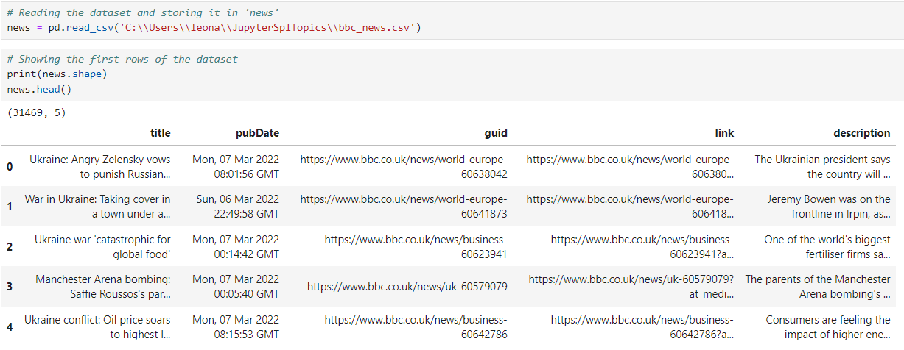
Sentiment Analysis (BBC News)
Reading the dataset

Slide 10
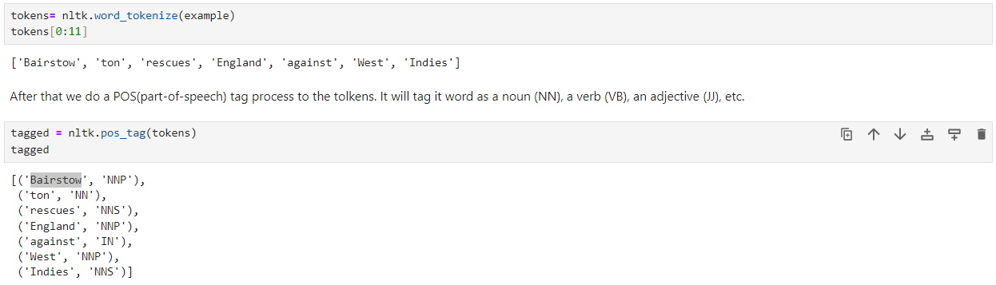
Sentiment Analysis (BBC News)
Tokenization
TITLE: “Jonny Bairstow's hundred rescues England after another batting collapse on day one of the first Test against West Indies in Antigua.”

Slide 11
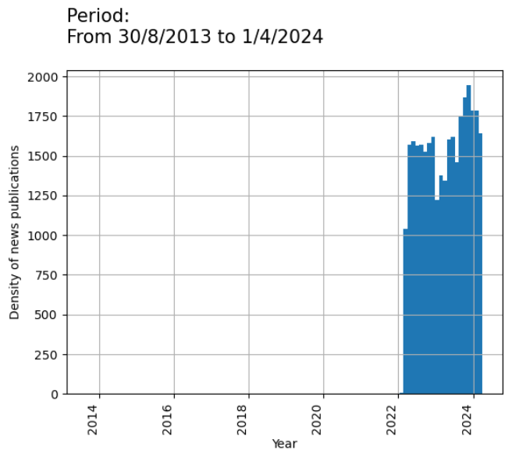
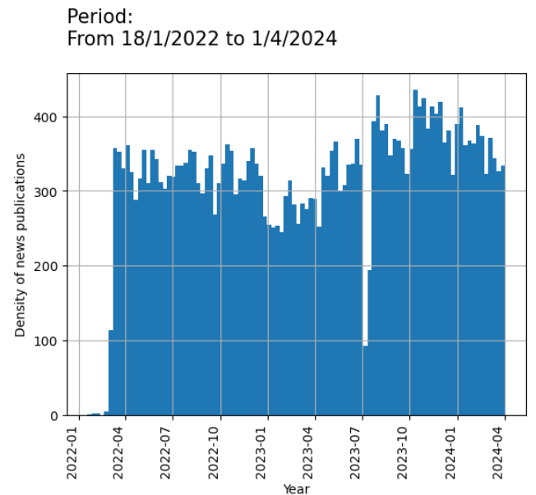
Sentiment Analysis (BBC News)
News Density

Slide 12
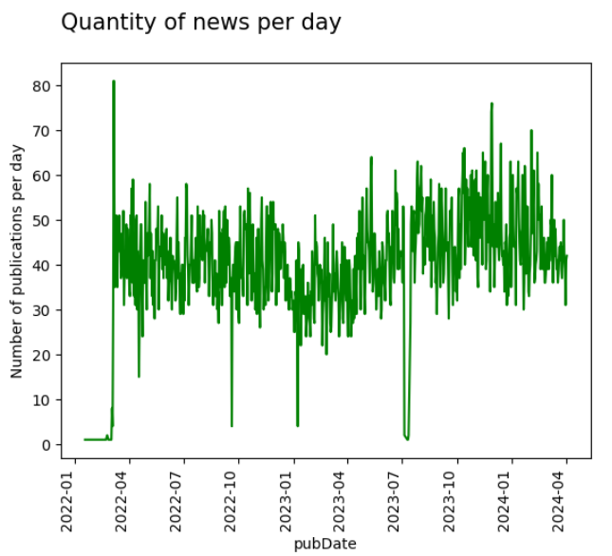
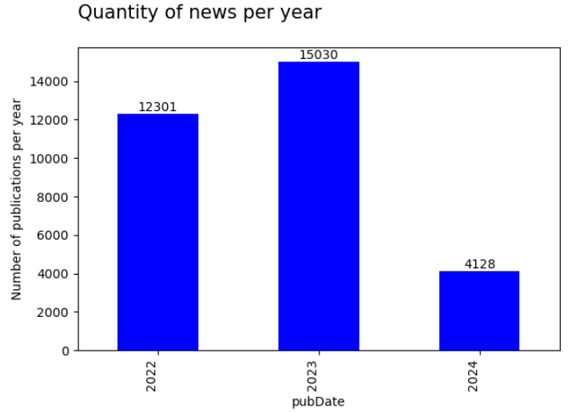
Sentiment Analysis (BBC News)
News Density

Slide 13
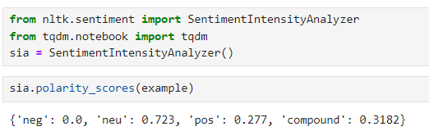
Sentiment Analysis (BBC News)
VADER Sentiment Score
VADER (Valence Aware Dictionary and sEntiment Reasoner) is rule-based sentiment analysis tool specifically designed for social media and news texts. It evaluates the sentiment of a piece of text (such as a sentence or paragraph) and assigns a sentiment score to it.
Score ranges from -1 to +1, where:
Close +1: indicates positive sentiment
Close to -1: indicates negative sentiment
Around 0 :indicates neutral sentiment
Example:
TITLE: “Jonny Bairstow's hundred rescues England after another batting collapse on day one of the first Test against West Indies in Antigua.”
The Compound sentiment is a single value index that represents the overall sentiment of the text. In this case, the compound score is 0.3182, which indicates a slightly positive sentiment overall.

Slide 14
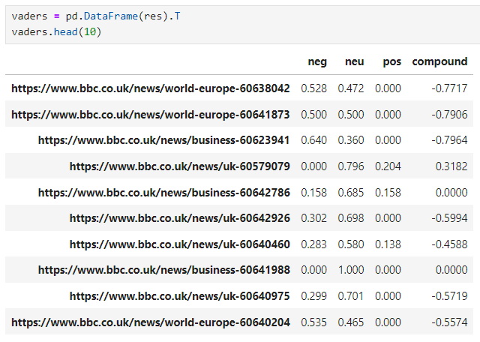
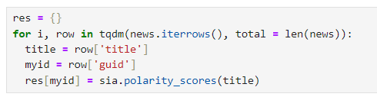
Sentiment Analysis (BBC News)
VADER Sentiment Score
Running VADER for the whole dataset:

Slide 15
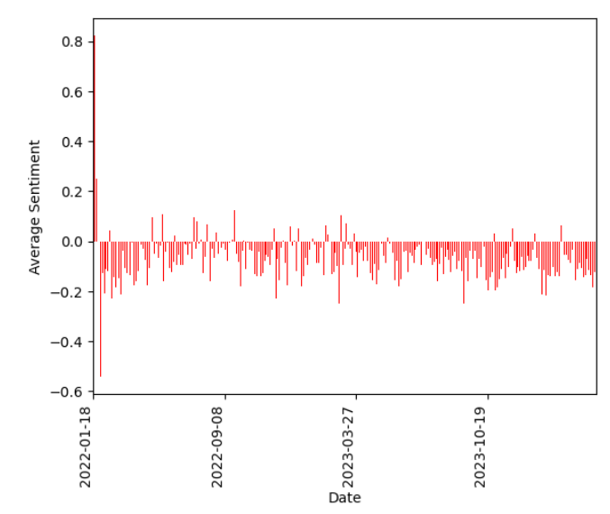
Sentiment Analysis (BBC News)
VADER Sentiment Score
Average Sentiment per Date

Slide 16
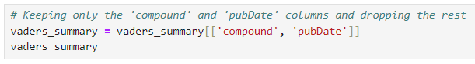
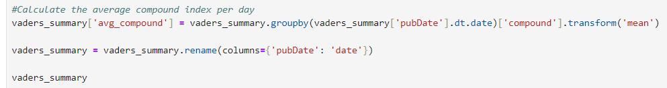
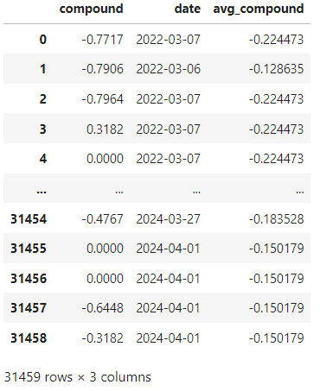
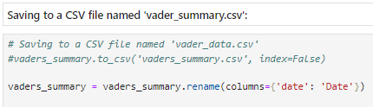
Sentiment Analysis (BBC News)
VADER Sentiment Score

Slide 17
LSTM

Slide 18
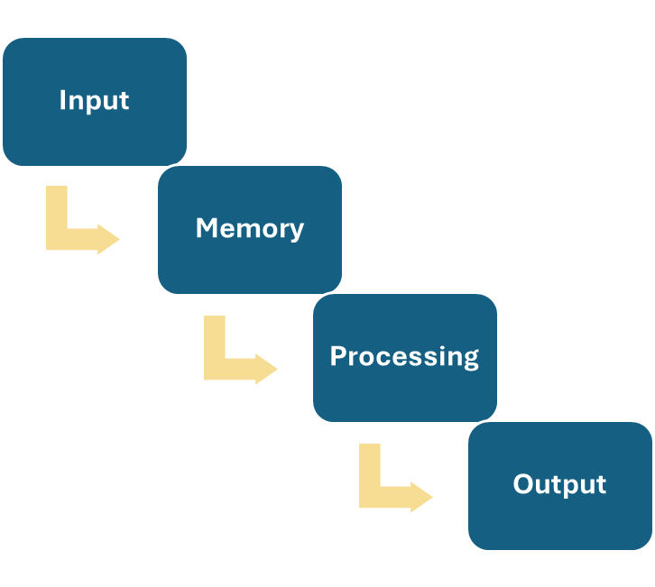
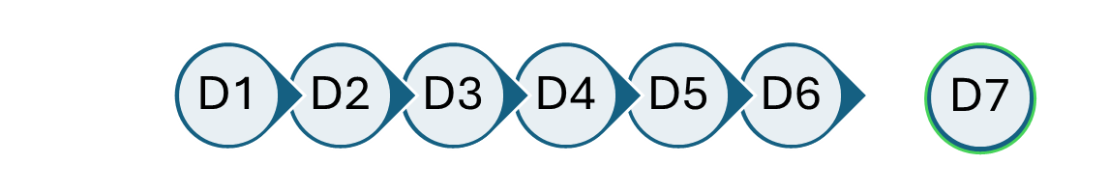
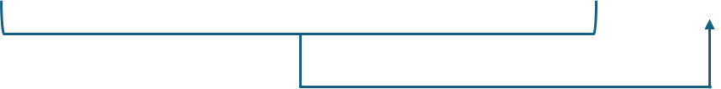
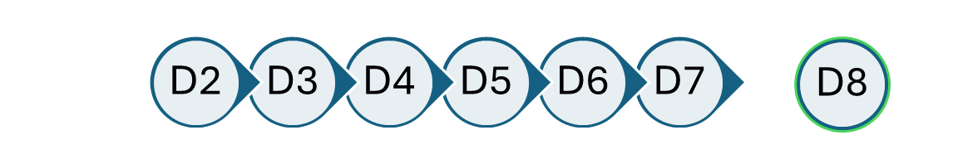
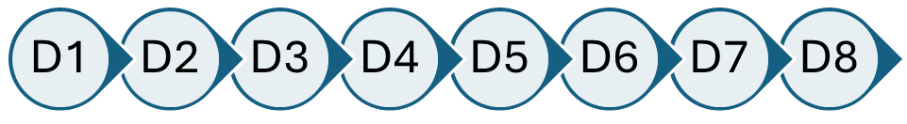
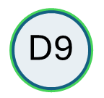
LSTM
It stands for Long Short-Term Memory. It learns from past data, like how to predict what comes next in a sequence of events.
Example: Dataset from D1 until D8.
Notes:
Input: LSTM takes in a sequence of data, in this case stock prices over time.
Memory: It stores information for long-term or short-term memory.
Processing: It goes through the sequence of data. It processes each piece of information while considering what it has remembered from the past.
Output: Based on its processing and memory, it makes predictions about what might come next in the sequence.

Slide 19
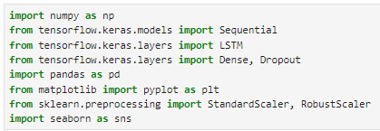
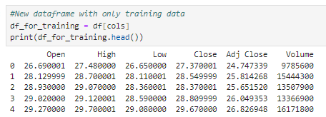
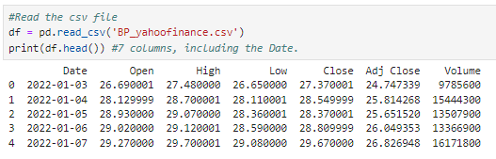
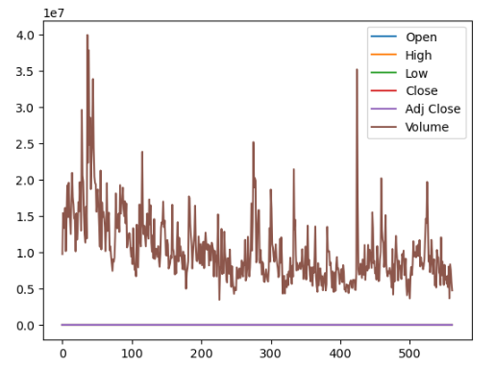
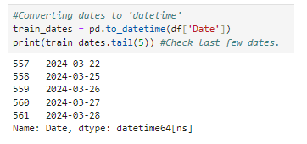
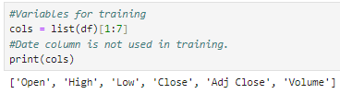
LSTM
Separating date only for plotting purpose
Date is not used for training

Slide 20
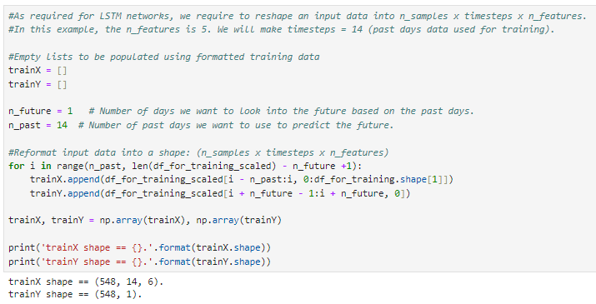

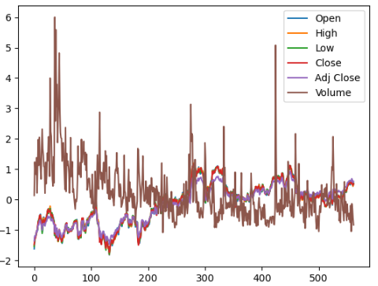
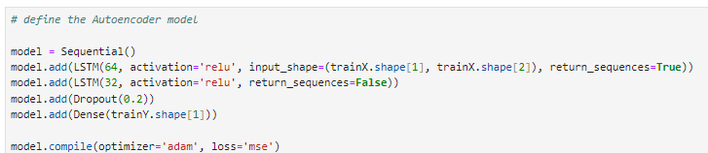
LSTM
Catching the training and prediction
548 (562-14) Rows / 14 Days / 6 Variables
Putting the model together
LSTM: with 64 units
Input shape: TrainX shape 1 and TrainX shape 2
Return sequence: True (because LSTM64 will return a sequence to LSTM 32
Optimizer ('adam’):

Slide 21
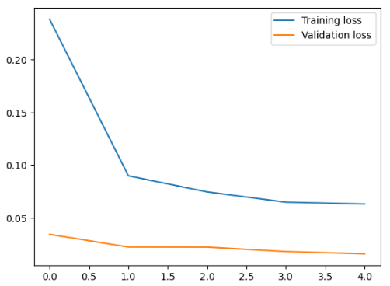
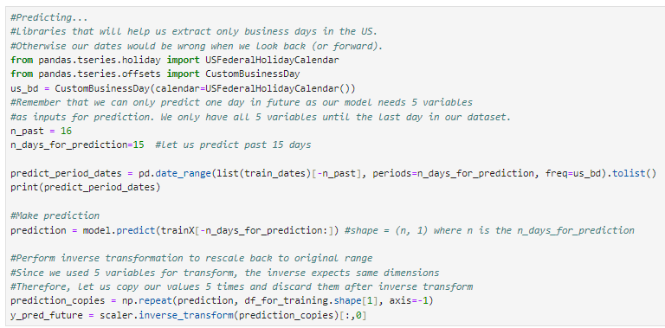
LSTM

Slide 22
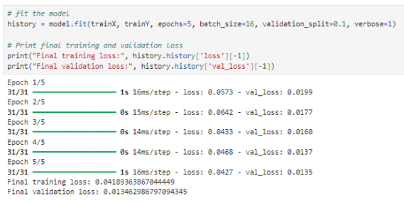
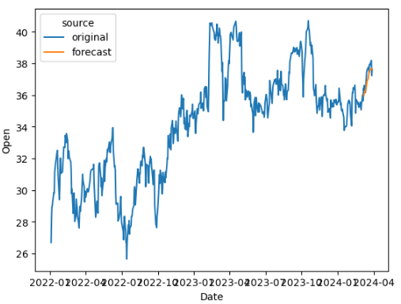
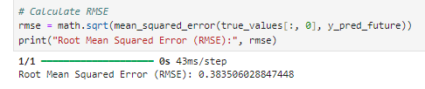
LSTM

Slide 23
LSTM + Sentiment Analysis

Slide 24
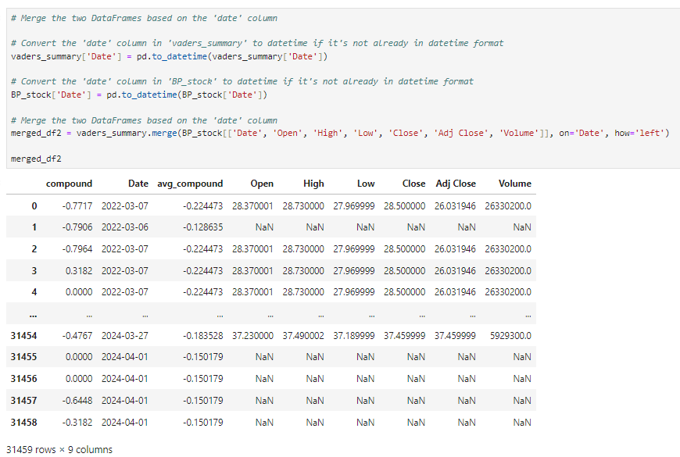
LSTM + Sentiment Analysis

Slide 25
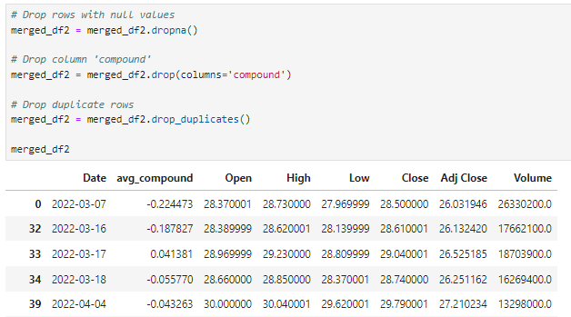

LSTM + Sentiment Analysis

Slide 26
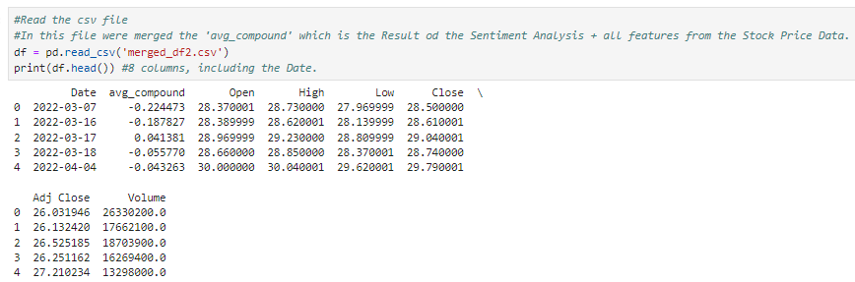
LSTM + Sentiment Analysis

Slide 27
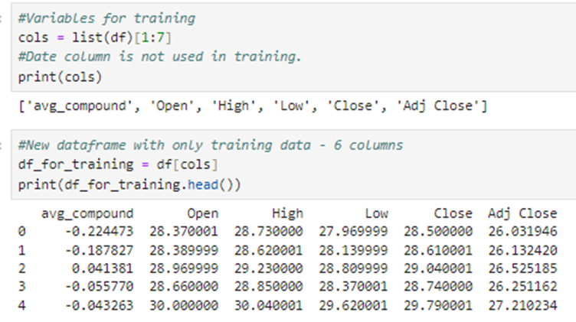

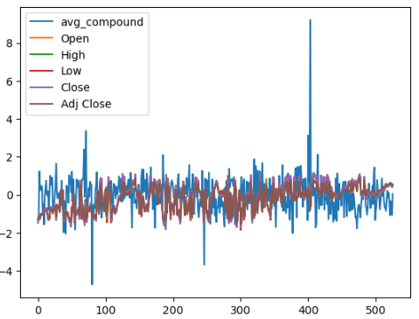
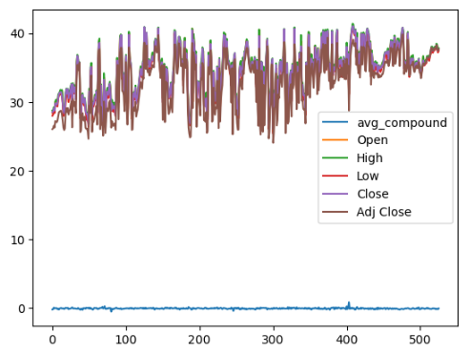
LSTM + Sentiment Analysis

Slide 28
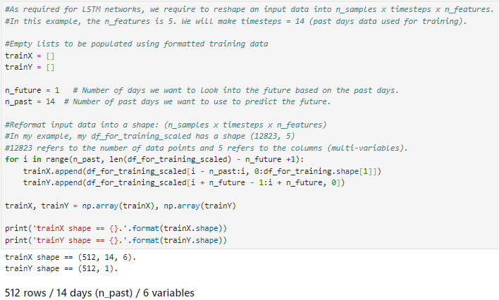
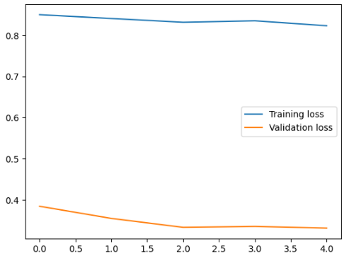
LSTM + Sentiment Analysis

Slide 29
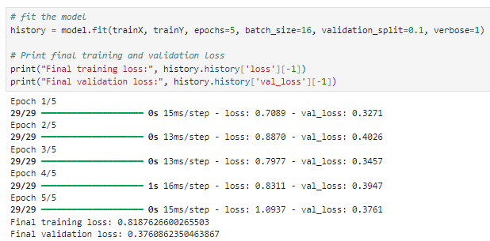
LSTM + Sentiment Analysis

Slide 30
Conclusion

Slide 31
Conclusion
LSTM (stock price)
LSTM (stock price + sentiment analysis)
In the model considering only stock price features, we had a final validation loss of 0.01. This indicates that the model was performing quite well on the validation data, making accurate predictions and generalizing well to unseen data.
However, after adding a new feature (sentiment analysis), the final validation loss increased to 0.37, suggesting that the model's performance worsened. It is not as accurate compared to the previous version of the model.
In conclusion, the addition of the new feature introduced some noise or complexity that the model couldn't effectively learn from, causing its performance to degrade.

Slide 32
What you learned / limitations of the models you applied
LIMITATIONS:
Sentiment Analysis: Roberta Hugging Face does not provide compound Index. Vader provides a clear compound Index.
LSTM: Requires large amounts of data for effective training.
WE LEARNED:
It is necessary dataset with specific topics for Sentiment Analysis.
It is necessary to map others meaningful variables to predict the prices.
It was an interesting exercise, but stock price prediction requires more complex understanding of the variables.

Slide 33
References

Slide 34
References
NEWS DATASET
Preda, G. (2024, April 9). BBC News. Kaggle.
https://www.kaggle.com/datasets/gpreda/bbc-news
BP STOCK PRICE DATASET
Yahoo! (2024, April 9). BP P.L.C. (BP) stock price, news, Quote & History.
https://ca.finance.yahoo.com/quote/BP?.tsrc=fin-srch
LSTM TUTORIAL
Sreeni. (2020, December 8). 181 - multivariate time series forecasting using LSTM.
https://www.youtube.com/watch?v=tepxdcepTbY
SENTIMENT ANALYSIS TUTORIAL
Mulla, R. (2022, May 5). Python sentiment analysis TUTORIAL. https://www.youtube.com/watch?v=QpzMWQvxXWk

Slide 35
References
Pre-recorded presentation:
https://www.youtube.com/watch?v=9fpOfcxMf90&t=755s
URL of original data:
https://www.kaggle.com/datasets/gpreda/bbc-news
https://ca.finance.yahoo.com/quote/BP?.tsrc=fin-srch
Python code (github):
https://github.com/LeoMeneguetti/CSIS4260_SpecialTopics

